Slide 1
CLR PARSER

Slide 2
CONTRIBUTION:
TEAM MEMBER | IMPLEMENTATION
NIDUMOLI GOWTHAMI PRIYA(RA1911028010140) | LR(1) Items, Parsing table
M.K.YASWANTH (RA1911028010135) | First and Follow, Parsing table
SAMPATH KUMAR, PRANEETH (RA1911028010138,RA1911028010095) | Display(Terminals & Non-terminals), Parsing table

Slide 3
INTRODUCTION
The CLR parser stands for canonical LR parser.It is a more powerful LR parser.It makes use of lookahead symbols. This method uses a large set of items called LR(1) items.The main difference between LR(0) and LR(1) items is that,in LR(1) items ,its possible to carry more information in a state,which will rule out useless reduction states.This extra information is incorporated into the state by the lookahead symbol. The general syntax becomes [A->∝.B, a ]
where A->∝.B is production and a is a terminal or right end marker $
LR(1) items=LR(0) items + look ahead

Slide 4
STEPS :
1. Augment the grammar
2. Find the FIRST & FOLLOW and number the production
3. Create the LR(1)Closure Item
4. Create the CLR Parsing table
5. Check the string acceptance (Stack implementation)

Slide 5
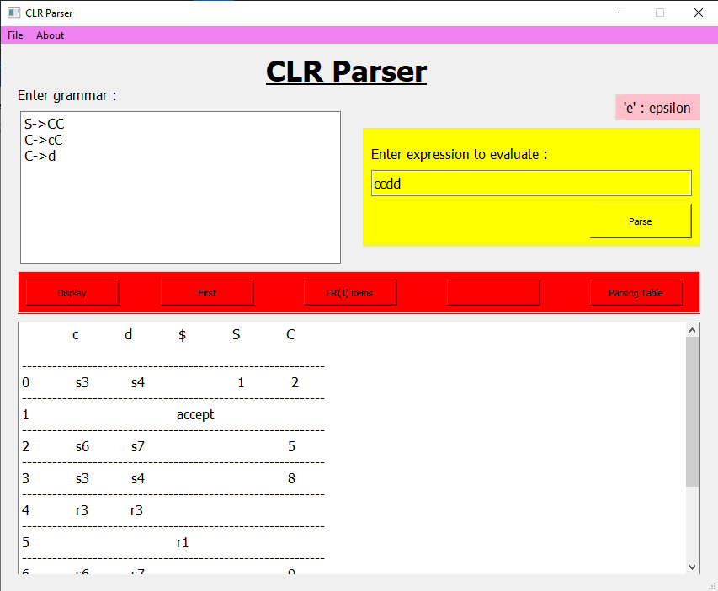
OUTPUT:

Slide 6
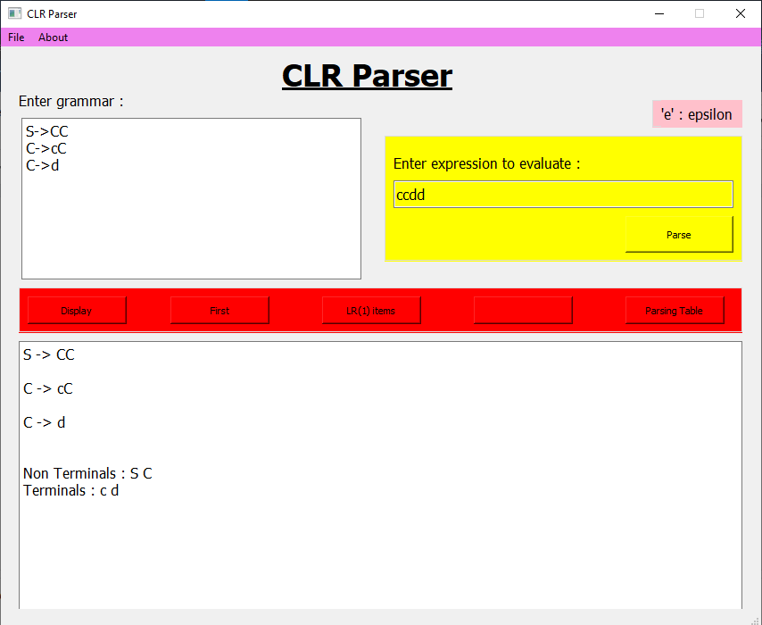

Slide 7
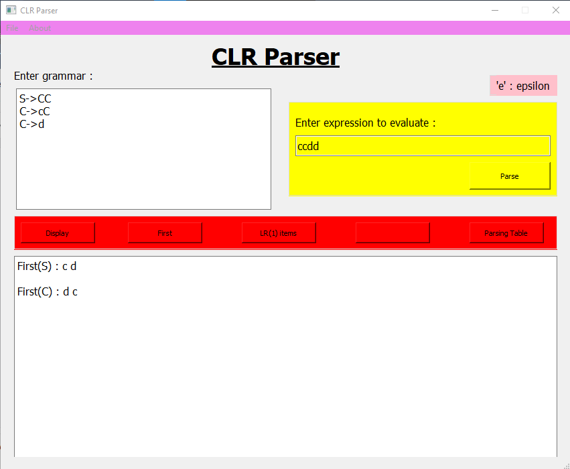

Slide 8
